Slide 1
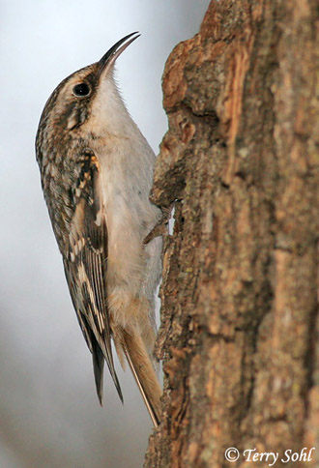
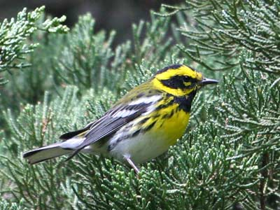
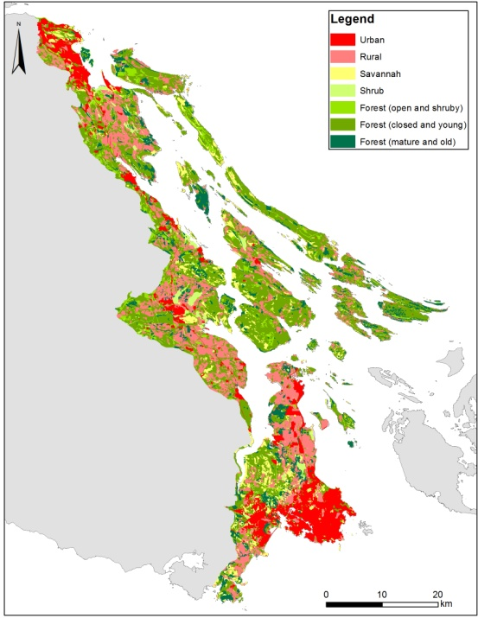
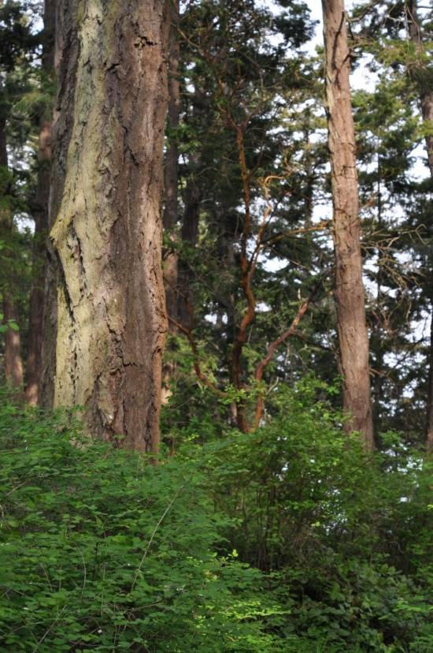
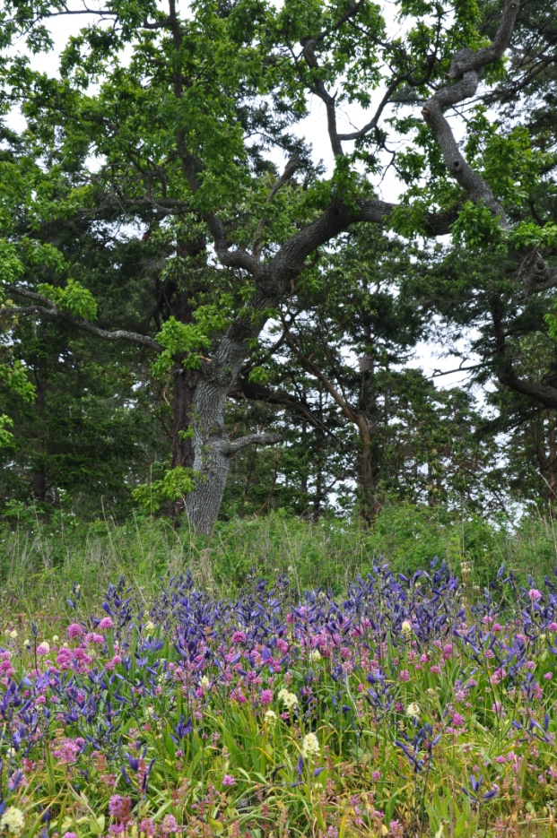
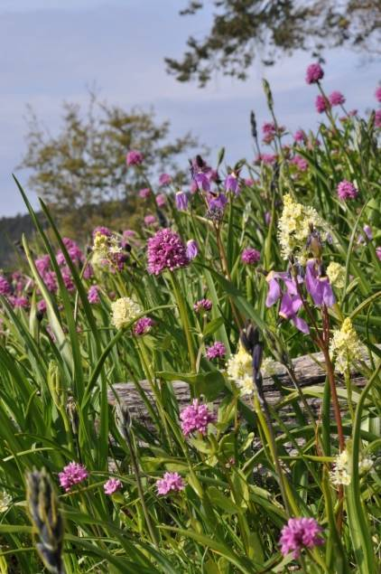
Economic Incentives for Conservation: Regulatory Targets, Offsets and Costs
Notes:
In the Douglas Fir/Garry Oak Woodlands of coastal BC, we are using SCAD to prioritize investments in land conservation, but doing so in a landscape were no ‘intact’ old-growth habitat remains. This raises the interesting question of where to start. In this talk, we’d like to attract your feedback on an evolving approach we are using to prioritize areas for the restoration of ‘old growth’ ecosystems, under the assumption that the best restoration candidates are those areas that currently support the richest communities of species thought to rely on historic habitat attributes.

Slide 2
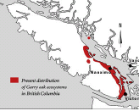

Forestry in the CDF
August 2005, 2009: Forest Practices Board Determines CDF log sales ‘unreasonable’
Reasons
20 Red-listed Species
“No Effective Mechanism to Conserve Red-listed” species
Instructions
Assess needs before further logging
Designate and Conserve Re-Listed Plant Communities

Slide 3
Regulatory Targets
Species At Risk
Critical Habitat now designated for 12 species in our planning area
Convention on Biodiversity
17% of terrestrial (10% of marine) ecosystems protected by 2020
Currently: ~9% in the CDF

Slide 4
Conservation Covenants
A Conservation Covenant is a legal commitment by a land owner to protect natural features on their property
Survey land to identify part to be protected
Identify ongoing management activities allowed or required
Estimate value of forgoing development to create a tax advantage

Slide 5

Incentives to Donors
Federal Ecological Gifts Program
Value of encumbering future development results in a tax deduction equal to the decline in land value
1110 ecological gifts valued over $716 million have been donated across Canada to protect 166,000 hectares of wildlife habitat

Slide 6
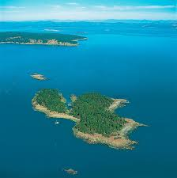
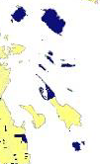
Little D`Arcy
One owner, purchased for $250K
c. 5ha, sub-dividable
Assessed $1,500K
Gifted 90% of Island to Canada
Value of gift reduced taxes to $0 for life

Slide 7

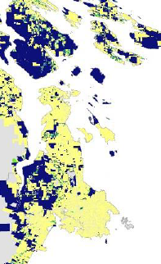
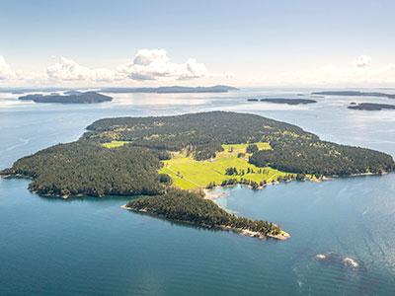
Incentives to Donors
Natural Area Protection Tax Exemption
Owners receive a 65% annual reduction on property taxes for portion of property protected with a NAPTEP covenant
One owner, 19 Parcels
Value ≈ $30 mil
Taxes ≈ $1,000,000
NAPTEP ≈ $650,000
ALR ≈ $850,000

Slide 8
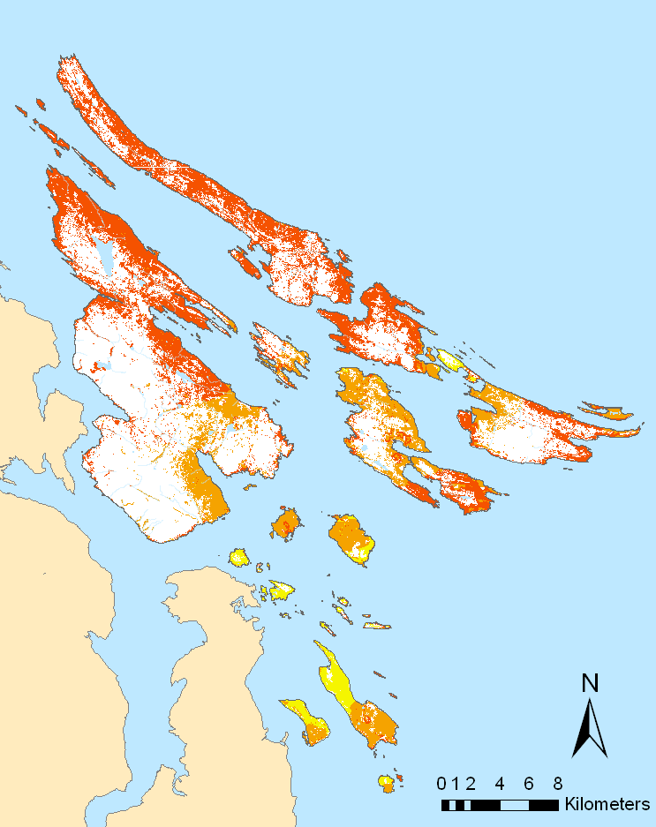
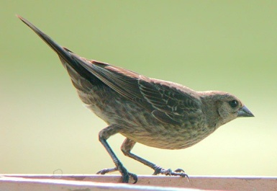
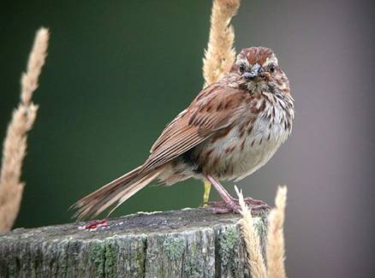
Expected Growth of Song Sparrow Populations Given Cowbird Distribution

Slide 9
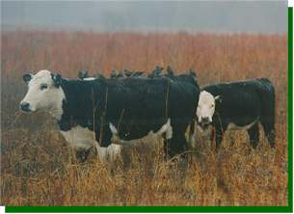
ALR Tax Incentive can be a Perverse Incentive
ALR Credit:
Pays Landowners to Degrade Habitat
Why Not ‘Pay’ to Promote Historic Habitat Conditions?

Slide 10
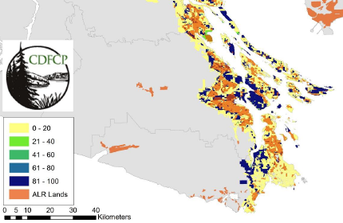
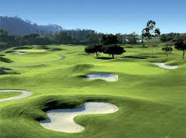
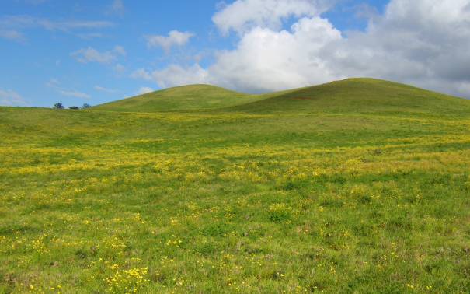
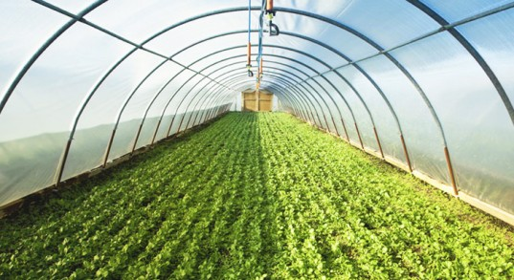
The Agricultural Land Reserve as Corridor and Buffer Habitat
To the Degree that ALR Enhances Conservation Outcomes, Planners Could Enhance Incentives to Maintain It

Slide 11
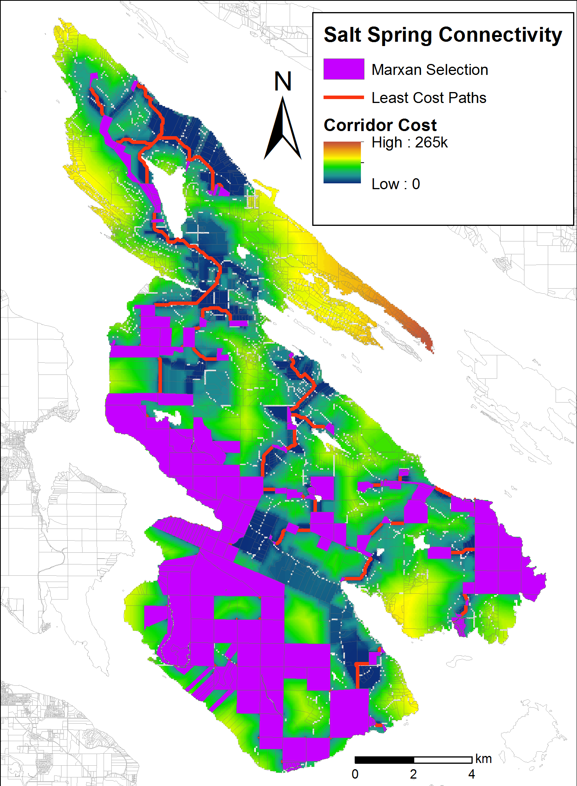
Stewardship Advice and Partnerships with Owners of High-value Conservation-Land
Examples:
NATEP covenants
Ecogifts
Organic farms
Ecosystem Services

Slide 12
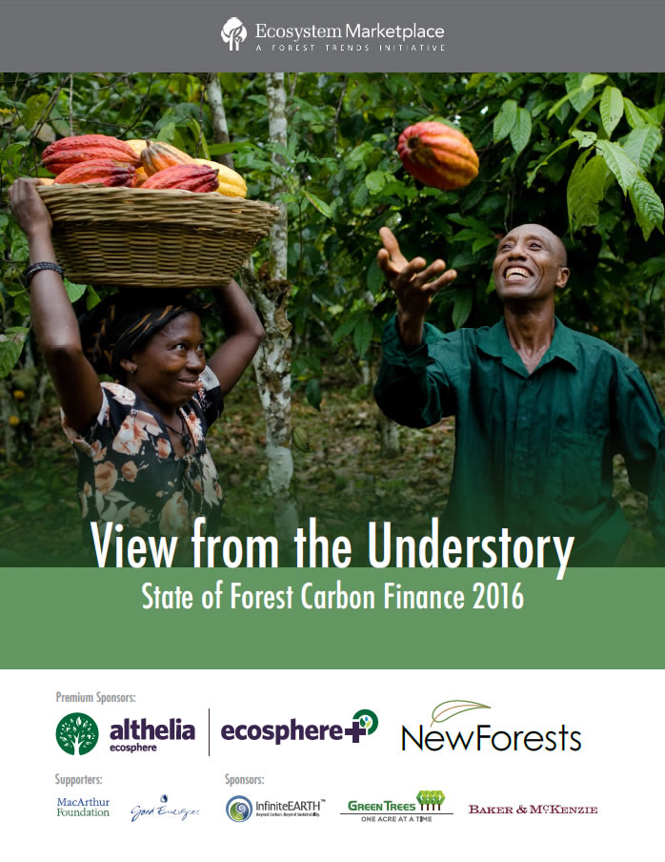
Payments for Ecosystem Services
$6 Billion Invested
to 2016 in Carbon

Slide 13
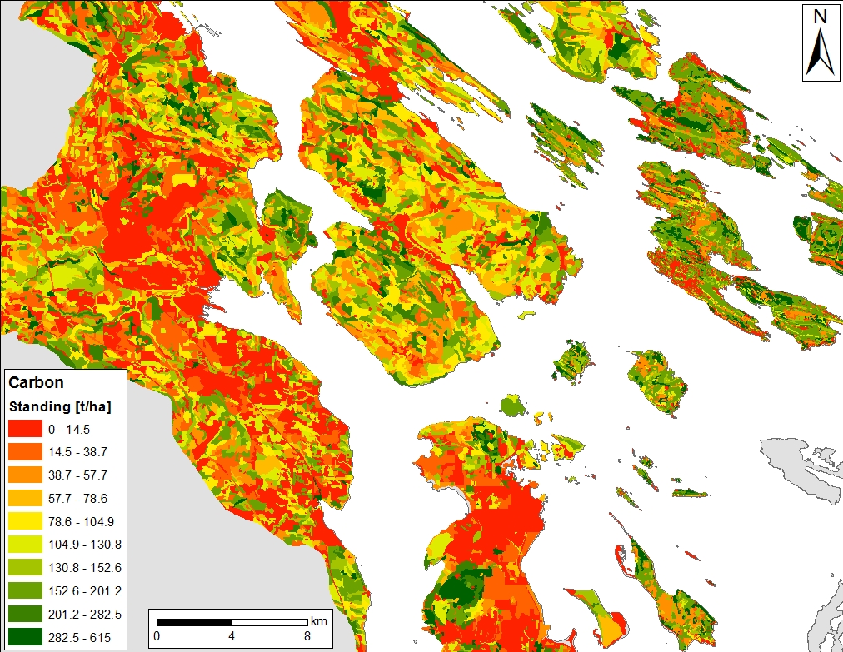
Synergies: High Value Forests Have Standing Carbon In Excess of 200 t/ha
Standing Carbon in High Value Forests in the Georgia Basin is Currently Worth $4-10K/ha
~3-15% of Acquisition Cost

Slide 14
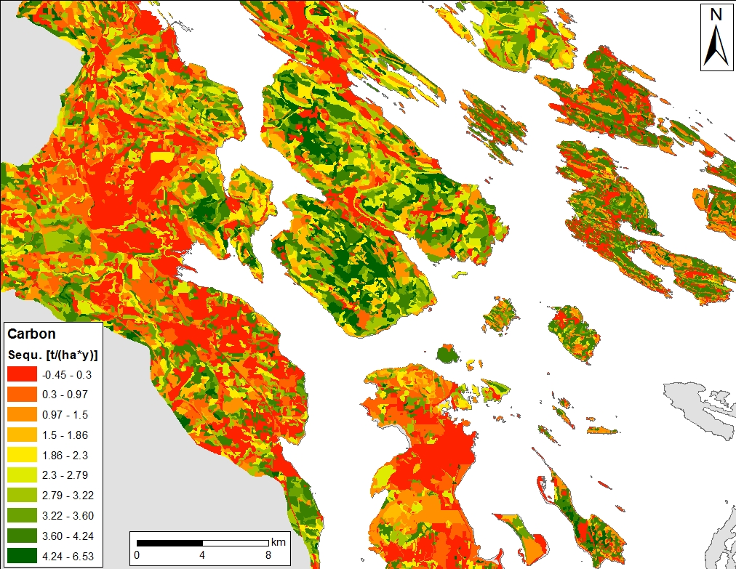
Synergies: High Value Forests Are Often Adjacent to Younger Forest With High Sequestration
High Sequestration Rates in Young Forest May Facilitate Landscape Level Planning

Slide 15
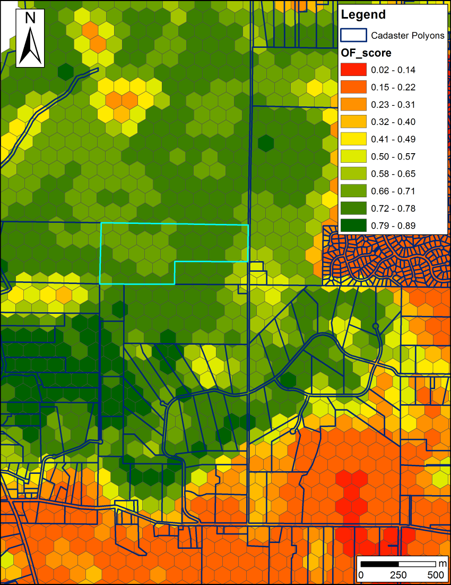
Biodiversity – Carbon Synergy in the Conservation of Forested Land
Biodiversity features
β-diversity of Old Forest and Savanna Bird Communities
Carbon budget model
Standing Carbon
Sequestration potential
Cost metrics used:
Total Land Value (TLV)
TLV – Standing Carbon * $/t
TLV – Sequestration Potential (20a) * $/t
TVL – Stand. Carb *$/t – Sequ. Pot. * $/t
$/t presented: 12.5 (average cost payed by Pacific Carbon Trust)

Slide 16
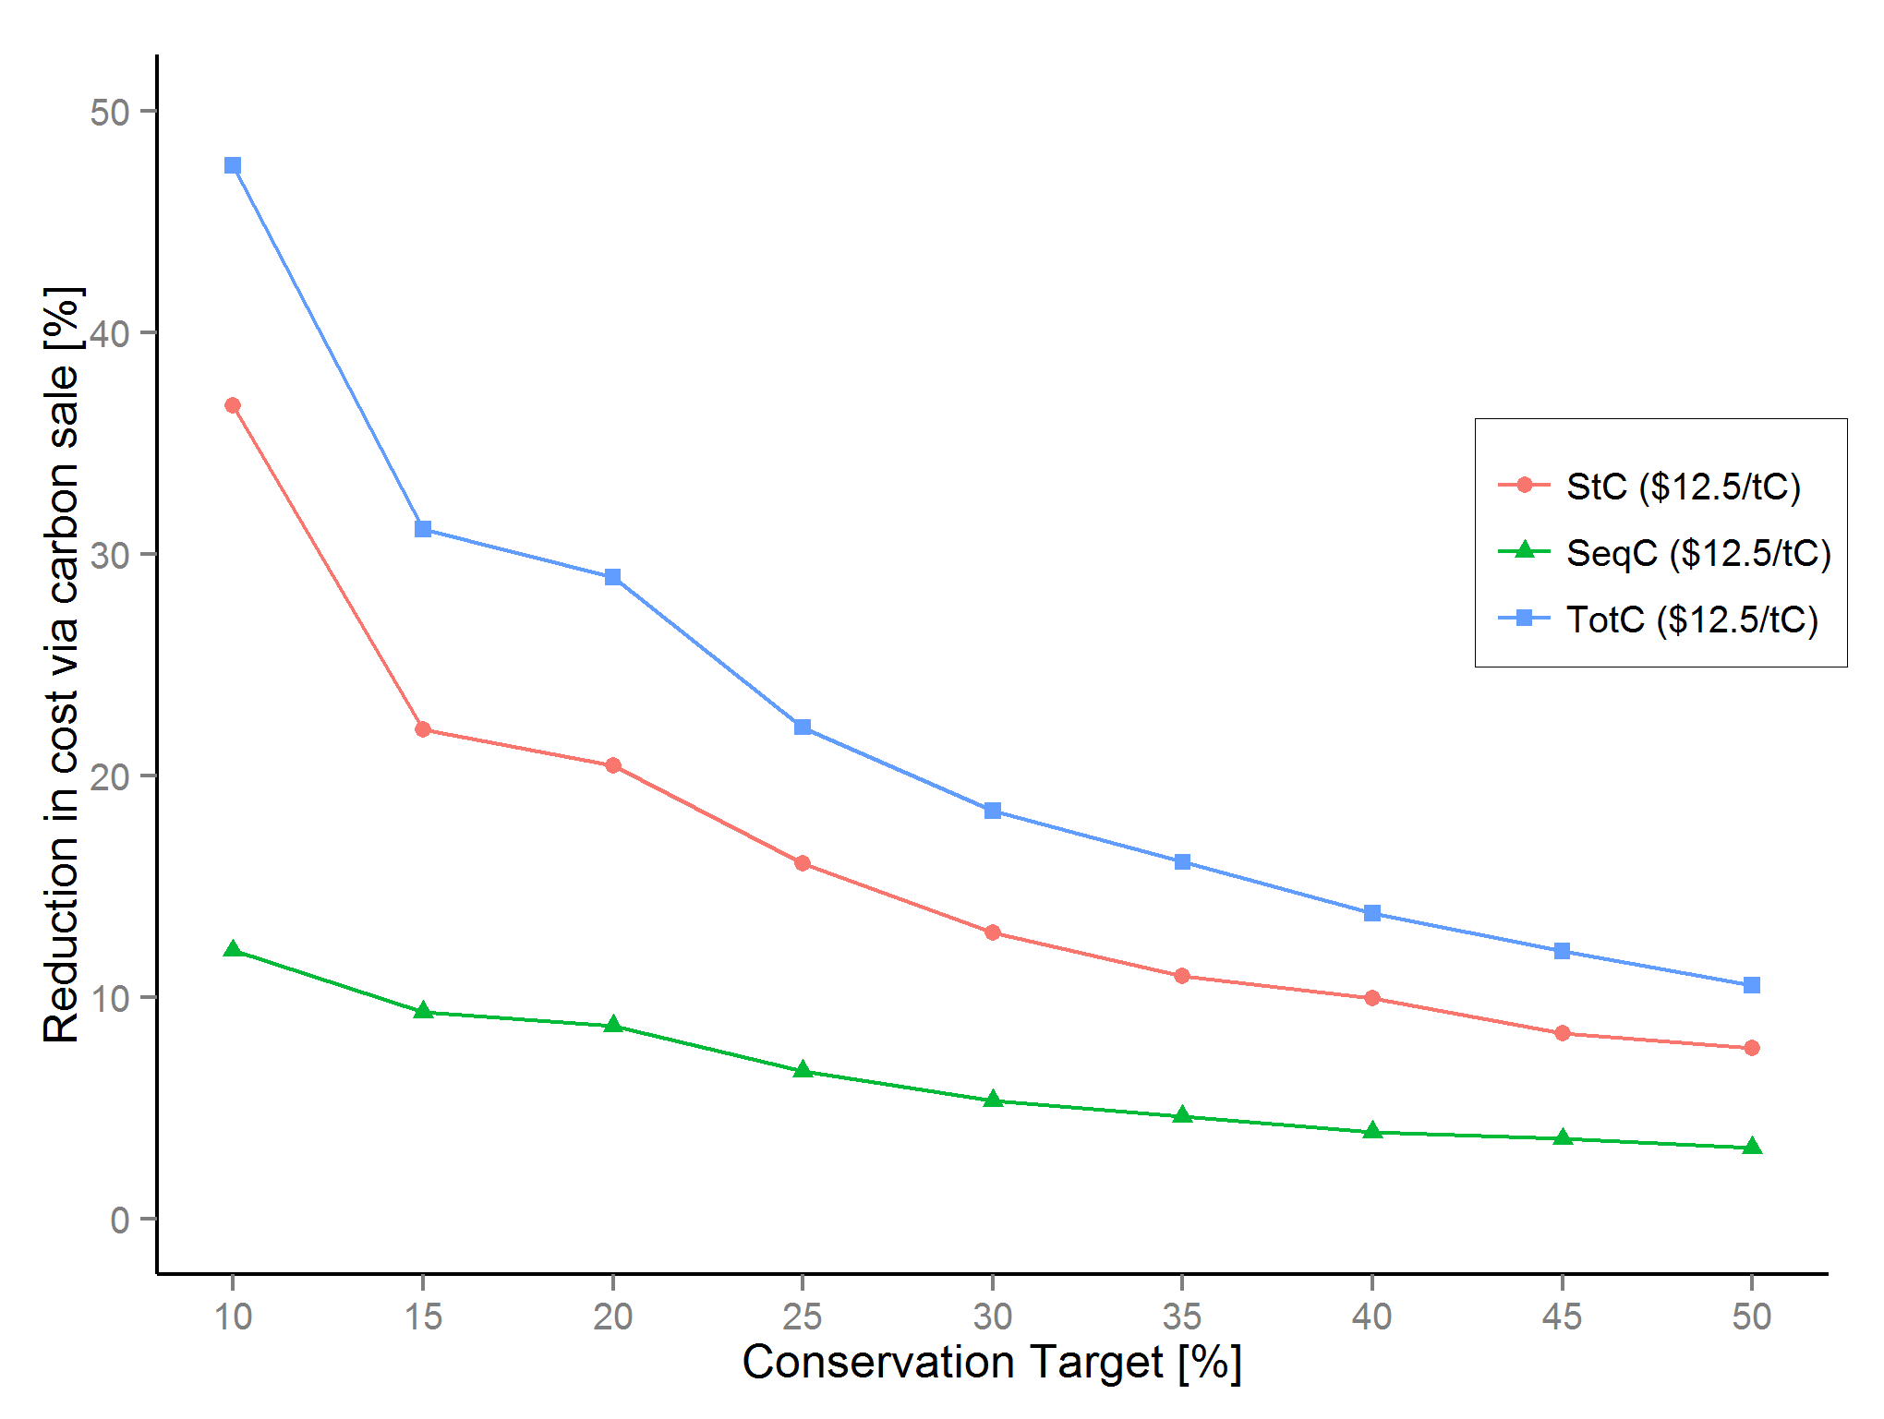
Biodiversity - Carbon
Huge Initial Reductions in Cost Possible
Schuster, Martin & Arcese 2014 PLoS One

Slide 17
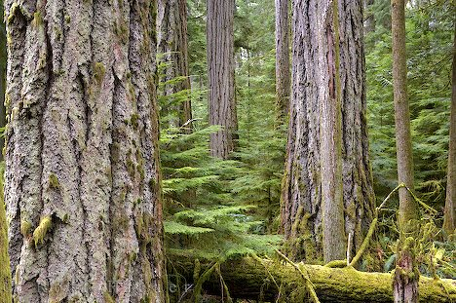
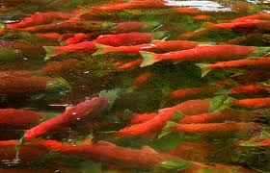

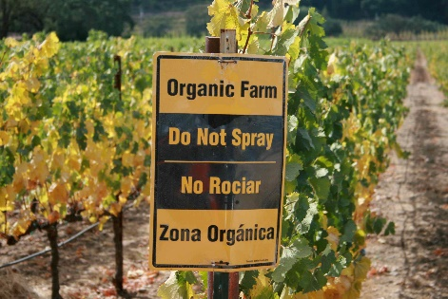
Strategic Investment for ‘Co-benefits’
Standing / Sequestered Carbon
Water Quality / Supply
Beneficial Farm Practices
Notes:
Think of a reverse auction as similar to when a homeowner solicits multiple bids for work from contractors. The homeowner puts together a scope of work, solicit bids, and chooses a contractor based on some combination of factors including price and quality.
Finally, based on estimates of the amount of habitat needed and the pricing of bids, BirdReturns accepted up to 80 percent of the bids. Each farmer received the price they bid. Just as with the contracting example, the lowest price didn’t always win, but it was a key criteria.
Farmer’s bids varied based on factors such as water cost, soil conditions, labor costs associated with creating the temporary habitat, and economic risks the program might create like not being able to plant on time in the spring.
BirdReturns has many advantages over conservation programs that set a single, uniform price for all farmers.
If the price is too low, there will be insufficient demand and too few farmers will sign up for the program. If the price is too high, there will be an excess of demand and the government will over-pay. In a time of huge societal needs and competing demands for scarce public dollars, such over-payment means that other valuable programs are not being funded.
In a reverse auction, the farmer sets the price, a price based on producing habitat. Farmers understand this intuitively. It is how they work, how they get paid for producing crops.
As one farmer put it at one of the Conservancy’s initial meetings: “You want us to grow birds, like we grow rice. We know how to do that.”
Farmer’s bids varied based on factors such as water cost, soil conditions, labor costs associated with creating the temporary habitat, and economic risks the program might create like not being able to plant on time in the spring.

Slide 18
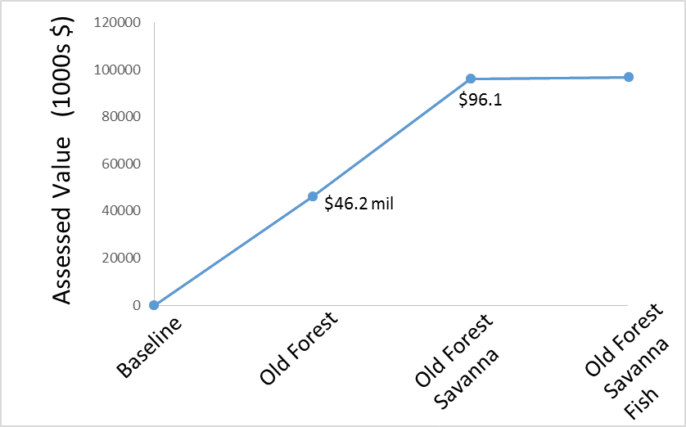
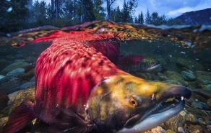
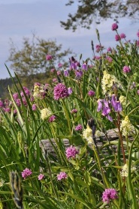
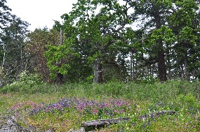
Coastal Douglas-fir Carbon Co-Benefit
$96.7
Vancouver

Slide 19
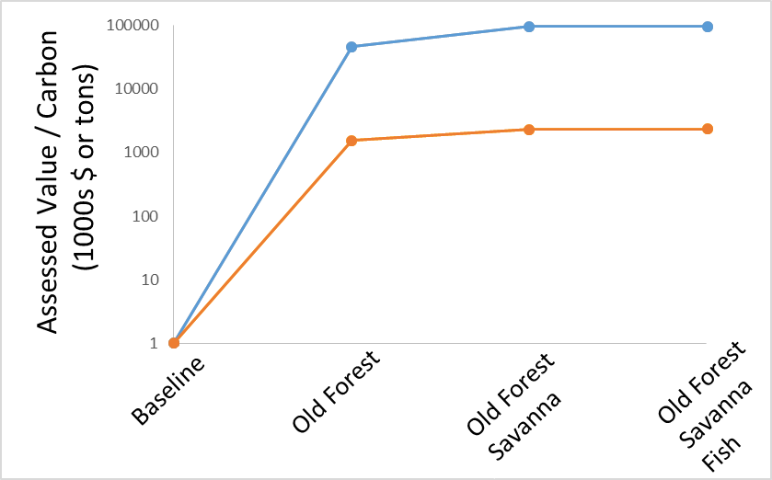
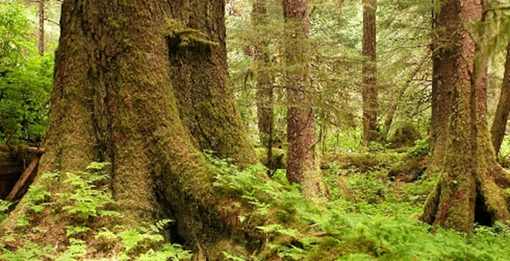
Coastal Douglas-fir Carbon Co-Benefit
Cost of Solution
St + Seq Carbon
$9.7
Canadian Carbon Policy
$20/t by 2020

Slide 20
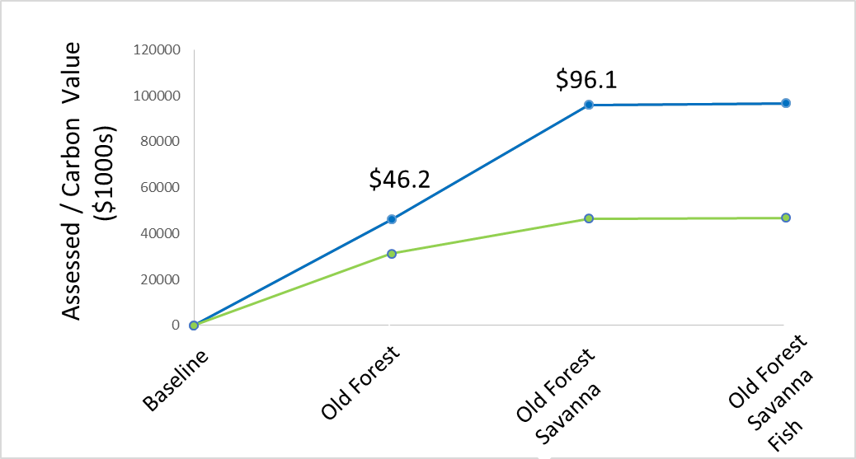
Coastal Douglas-fir Carbon
Co-Benefit
$9.7
$96.7
Who Pays?
Assessed Value - Carbon ($1000s)
$31.2 $46.4 $46.8

Slide 21
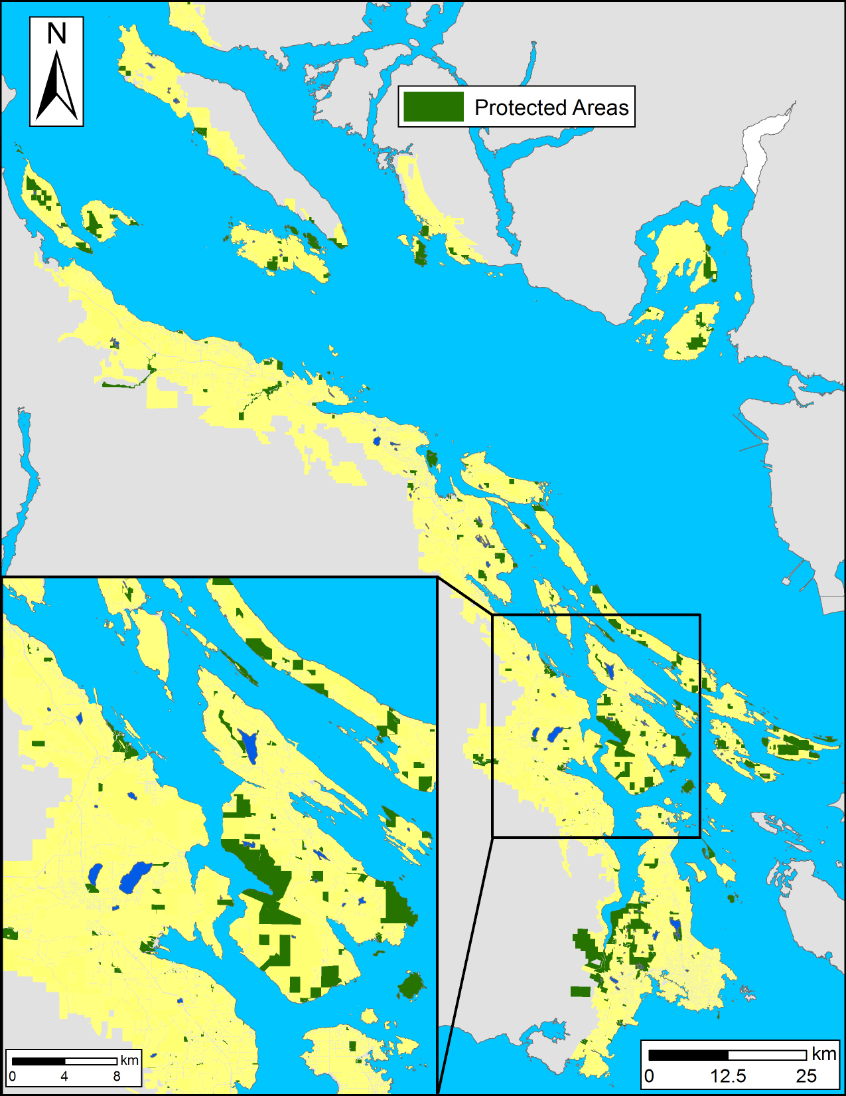
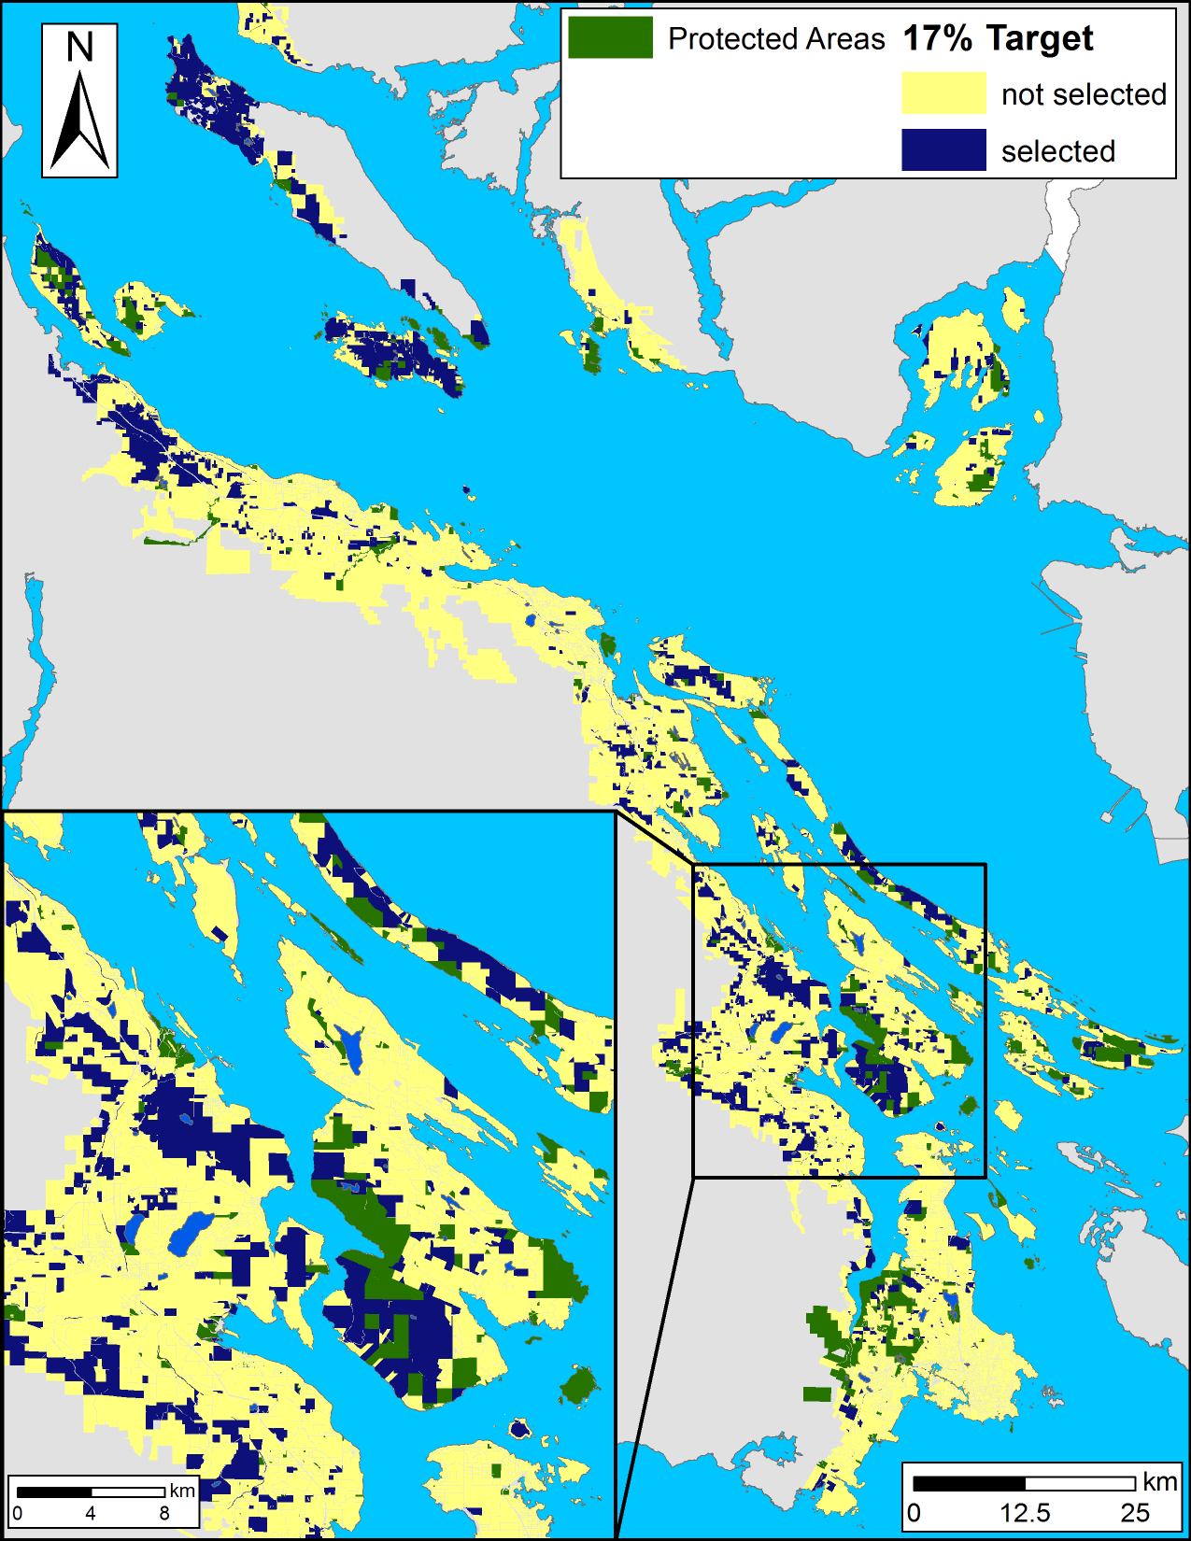
Coastal Douglas-fir
Conservation Partnership Study Area
Meeting Our Commitment to Convention on Biological Diversity
to Increase Protection to 17% from 10% Currently
Cost: $360M

Slide 22
Financing Conservation via ‘Tax Shifting’
Municipal & Provincial Governments Committed to Reduce Net Carbon
Shift Property Tax from High to Low Ranked Parcels to Reflect Existing or Restore Ecosystem Services
Reduction Cost Required Shift
100% $3.13m $2.10 / $1mil
Schuster et al. 2017 Cons. Lett.

Slide 23
Strategic Investment for ‘Co-benefits’
Standing / Sequestered Carbon
Water Quality / Supply
Beneficial Farm Practices
Notes:
Think of a reverse auction as similar to when a homeowner solicits multiple bids for work from contractors. The homeowner puts together a scope of work, solicit bids, and chooses a contractor based on some combination of factors including price and quality.
Finally, based on estimates of the amount of habitat needed and the pricing of bids, BirdReturns accepted up to 80 percent of the bids. Each farmer received the price they bid. Just as with the contracting example, the lowest price didn’t always win, but it was a key criteria.
Farmer’s bids varied based on factors such as water cost, soil conditions, labor costs associated with creating the temporary habitat, and economic risks the program might create like not being able to plant on time in the spring.
BirdReturns has many advantages over conservation programs that set a single, uniform price for all farmers.
If the price is too low, there will be insufficient demand and too few farmers will sign up for the program. If the price is too high, there will be an excess of demand and the government will over-pay. In a time of huge societal needs and competing demands for scarce public dollars, such over-payment means that other valuable programs are not being funded.
In a reverse auction, the farmer sets the price, a price based on producing habitat. Farmers understand this intuitively. It is how they work, how they get paid for producing crops.
As one farmer put it at one of the Conservancy’s initial meetings: “You want us to grow birds, like we grow rice. We know how to do that.”
Farmer’s bids varied based on factors such as water cost, soil conditions, labor costs associated with creating the temporary habitat, and economic risks the program might create like not being able to plant on time in the spring.

Slide 24
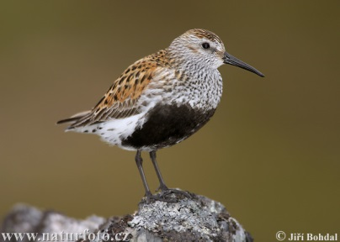
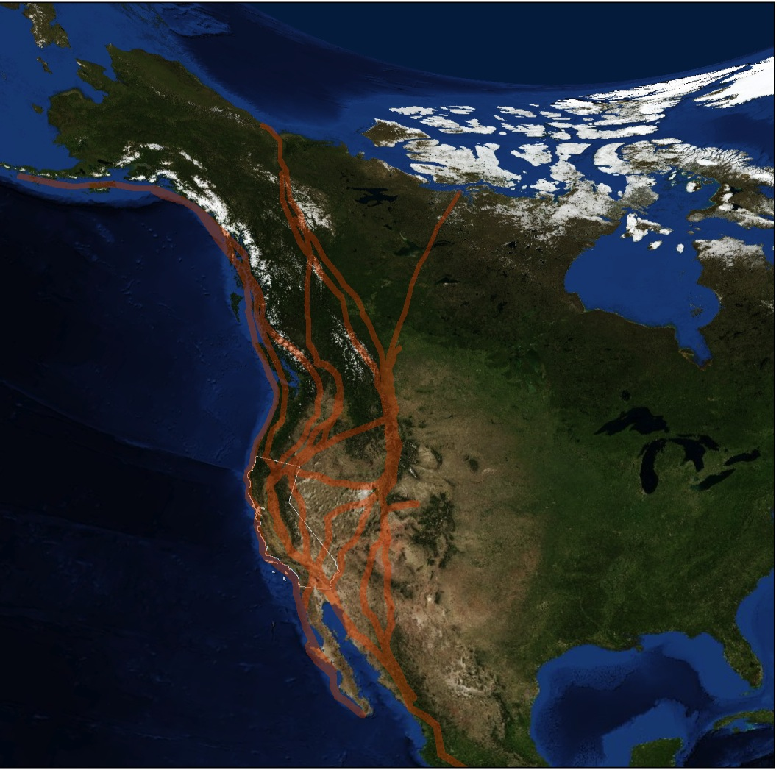
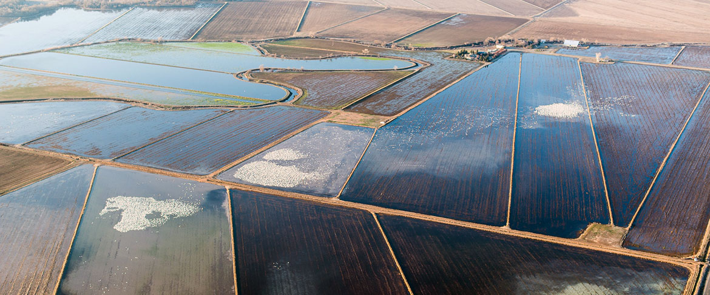
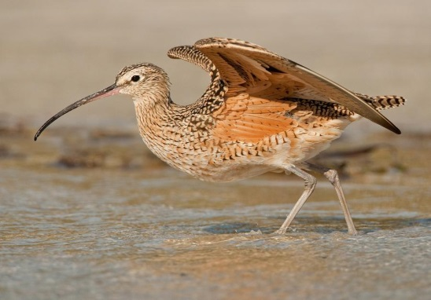
Sacramento Valley Rice Fields – TNC

Slide 25
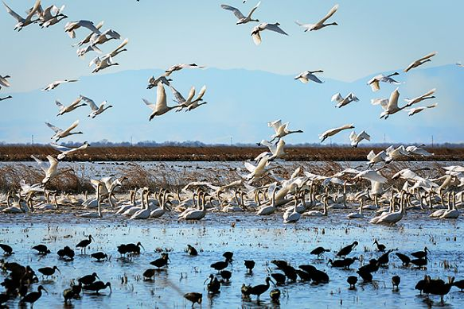
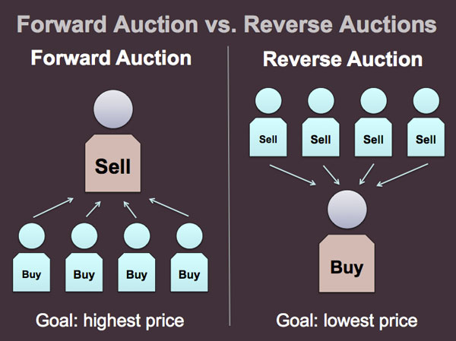
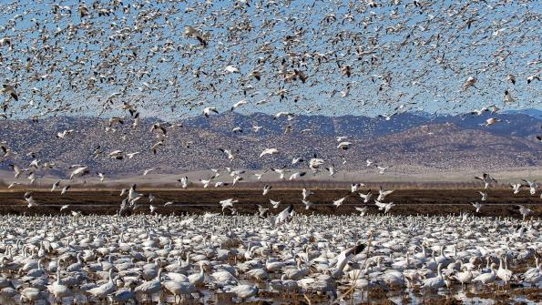
Reverse Auctions
Notes:
Think of a reverse auction as similar to when a homeowner solicits multiple bids for work from contractors. The homeowner puts together a scope of work, solicit bids, and chooses a contractor based on some combination of factors including price and quality.
Finally, based on estimates of the amount of habitat needed and the pricing of bids, BirdReturns accepted up to 80 percent of the bids. Each farmer received the price they bid. Just as with the contracting example, the lowest price didn’t always win, but it was a key criteria.
Farmer’s bids varied based on factors such as water cost, soil conditions, labor costs associated with creating the temporary habitat, and economic risks the program might create like not being able to plant on time in the spring.
BirdReturns has many advantages over conservation programs that set a single, uniform price for all farmers.
If the price is too low, there will be insufficient demand and too few farmers will sign up for the program. If the price is too high, there will be an excess of demand and the government will over-pay. In a time of huge societal needs and competing demands for scarce public dollars, such over-payment means that other valuable programs are not being funded.
In a reverse auction, the farmer sets the price, a price based on producing habitat. Farmers understand this intuitively. It is how they work, how they get paid for producing crops.
As one farmer put it at one of the Conservancy’s initial meetings: “You want us to grow birds, like we grow rice. We know how to do that.”
Farmer’s bids varied based on factors such as water cost, soil conditions, labor costs associated with creating the temporary habitat, and economic risks the program might create like not being able to plant on time in the spring.

Slide 26
Strategic Investment for ‘Co-benefits’
Standing / Sequestered Carbon
Water Quality / Supply
Beneficial Farm Practices
Notes:
Think of a reverse auction as similar to when a homeowner solicits multiple bids for work from contractors. The homeowner puts together a scope of work, solicit bids, and chooses a contractor based on some combination of factors including price and quality.
Finally, based on estimates of the amount of habitat needed and the pricing of bids, BirdReturns accepted up to 80 percent of the bids. Each farmer received the price they bid. Just as with the contracting example, the lowest price didn’t always win, but it was a key criteria.
Farmer’s bids varied based on factors such as water cost, soil conditions, labor costs associated with creating the temporary habitat, and economic risks the program might create like not being able to plant on time in the spring.
BirdReturns has many advantages over conservation programs that set a single, uniform price for all farmers.
If the price is too low, there will be insufficient demand and too few farmers will sign up for the program. If the price is too high, there will be an excess of demand and the government will over-pay. In a time of huge societal needs and competing demands for scarce public dollars, such over-payment means that other valuable programs are not being funded.
In a reverse auction, the farmer sets the price, a price based on producing habitat. Farmers understand this intuitively. It is how they work, how they get paid for producing crops.
As one farmer put it at one of the Conservancy’s initial meetings: “You want us to grow birds, like we grow rice. We know how to do that.”
Farmer’s bids varied based on factors such as water cost, soil conditions, labor costs associated with creating the temporary habitat, and economic risks the program might create like not being able to plant on time in the spring.

Slide 27

Conclusions
Composite Occupancy Maps Offer a Direct Route to Site Prioritization
Parcel-level Prioritization Aids Decision-making by Engaging Stakeholders in Targets, Goal-setting and Policy Scenarios
Of ~600 Species At Risk in Canada, ~450 Rely on Human-dominated Landscapes, where <10% of Historic Ecosystems have been Conserved
Meeting Treaty Targets to Conserve 17% of Terrestrial Ecosystems and Stem Extinction will Require Strategic Incentivizes to Conserve Private Land

